Slide 1
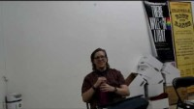
Notes:
[21] Here is some rehearsal footage.

Slide 2
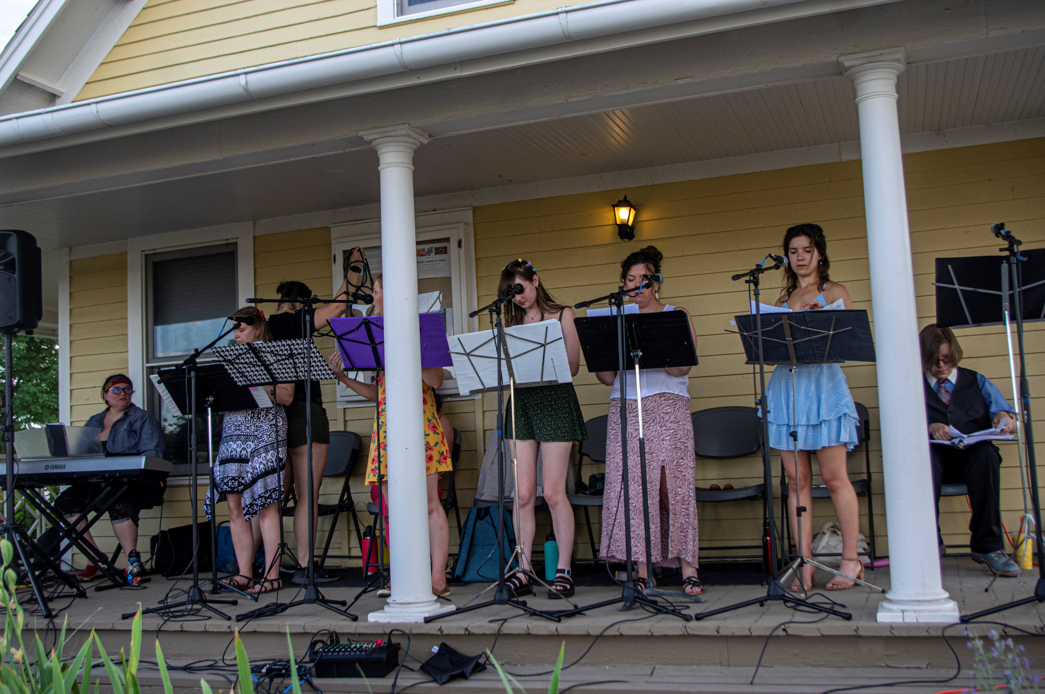
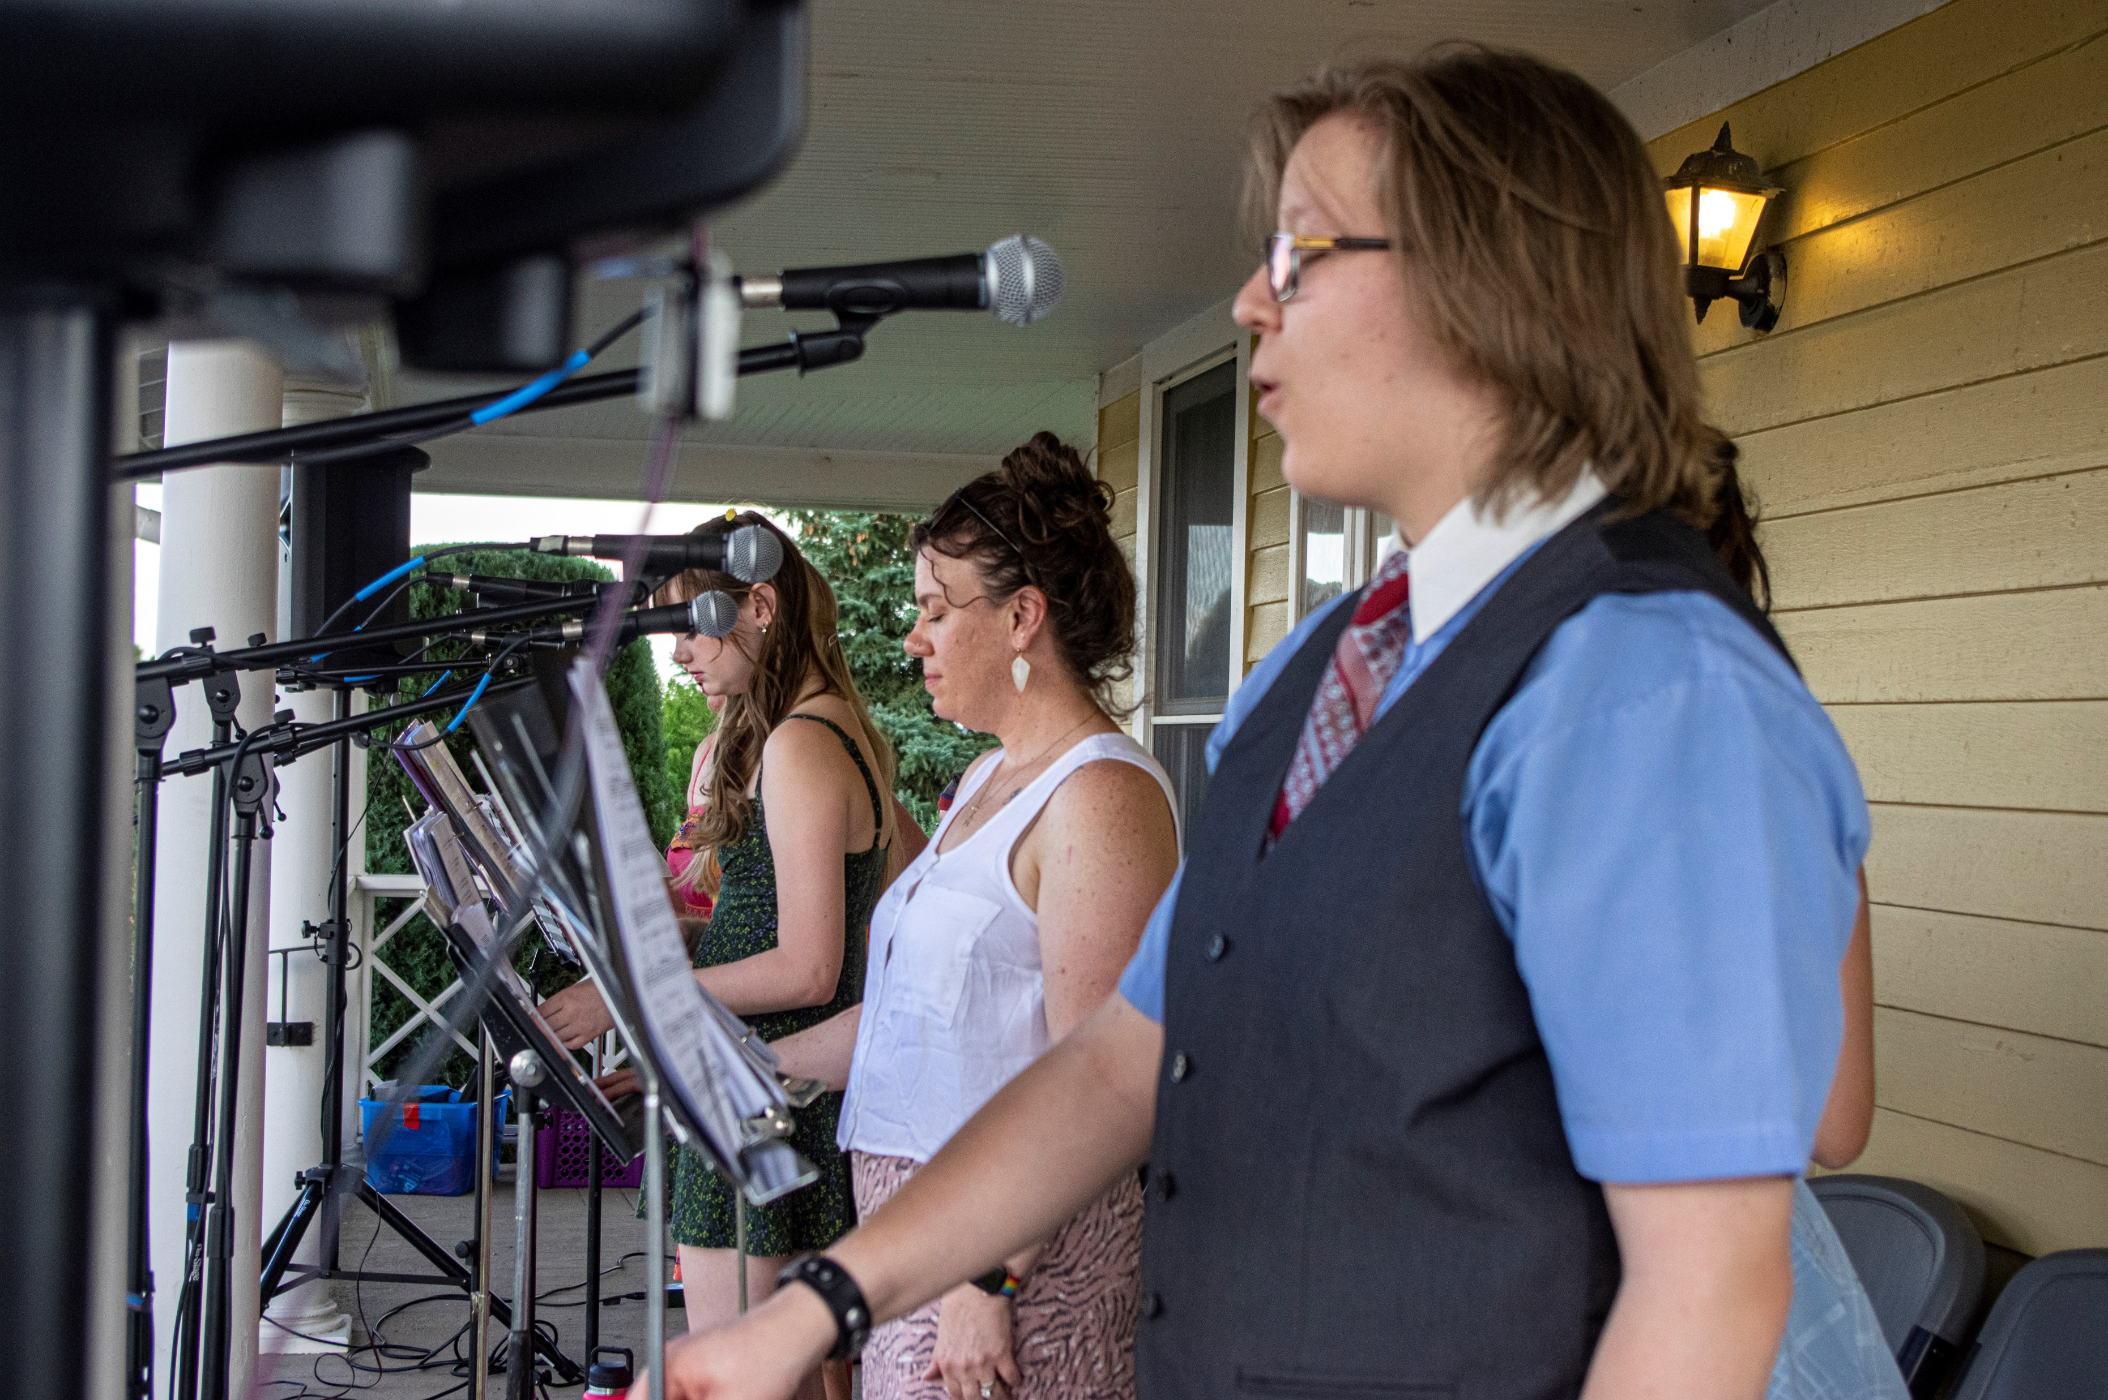
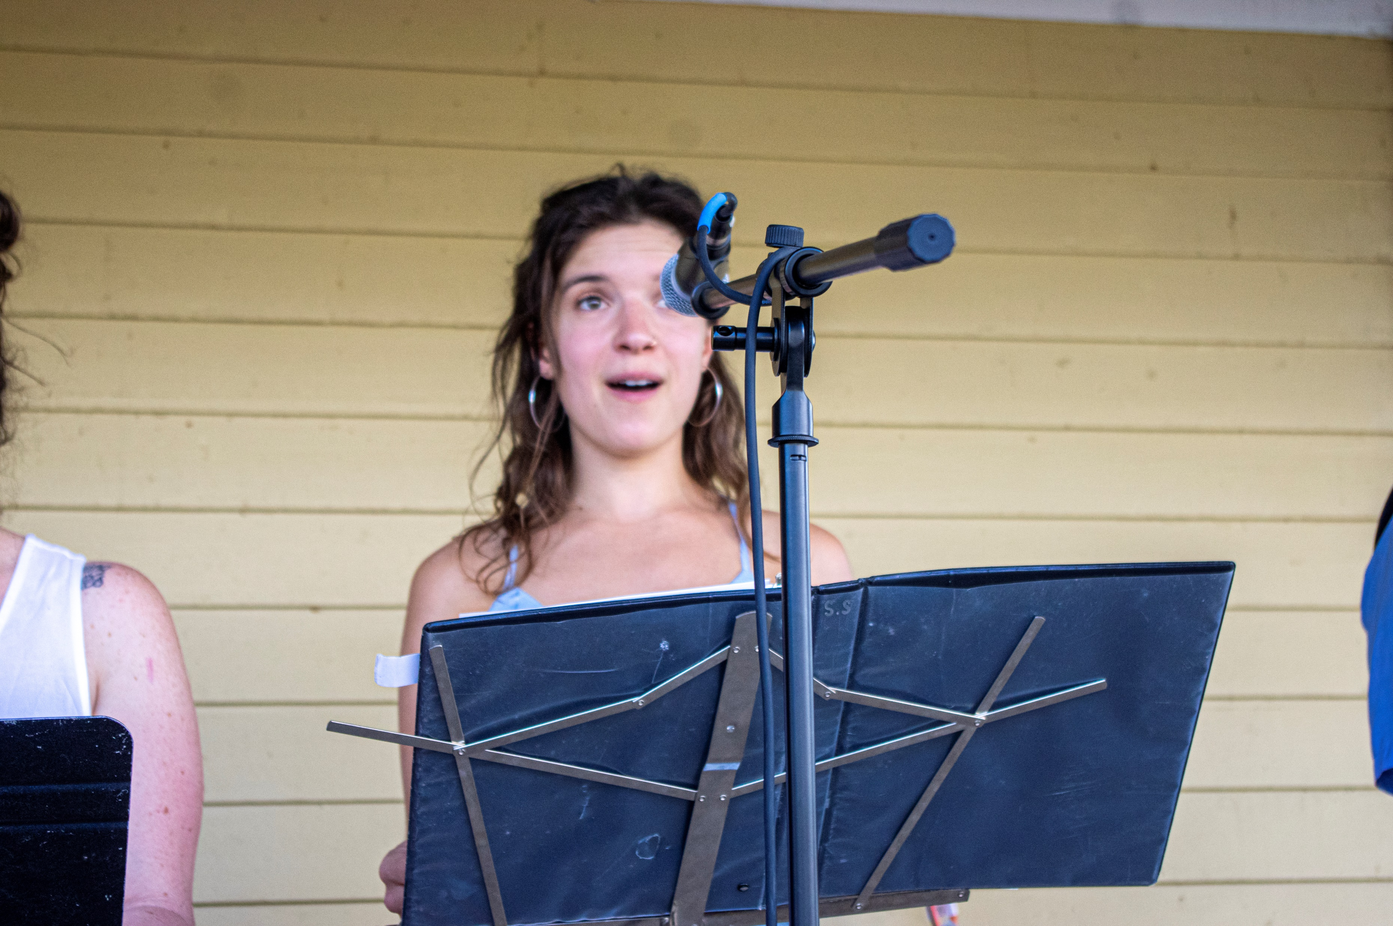
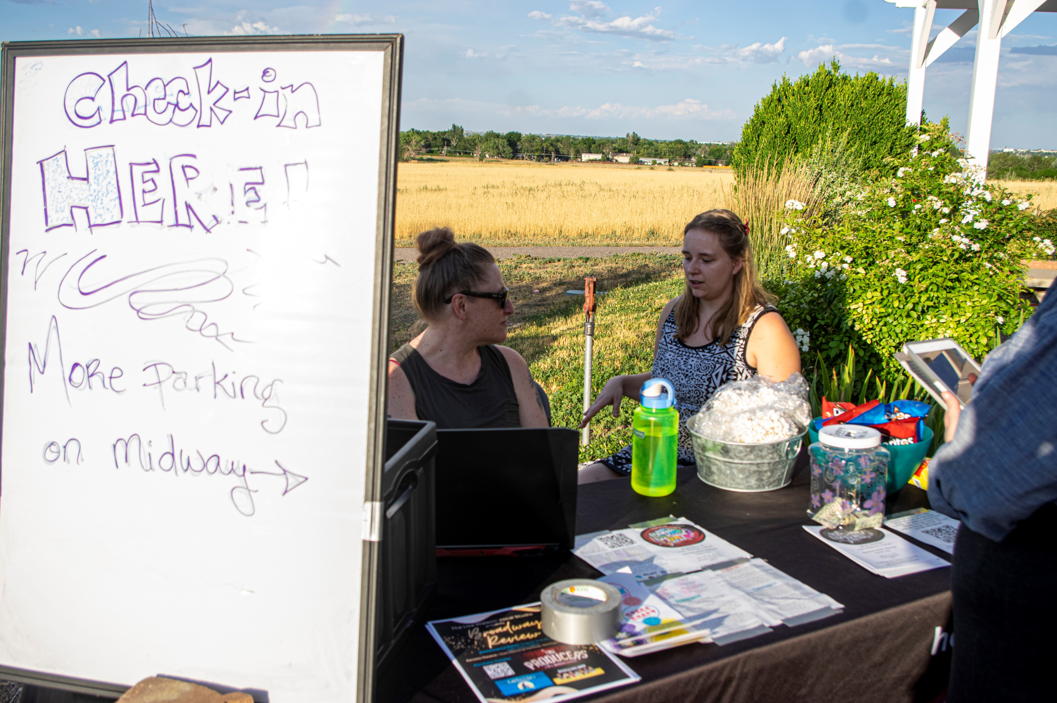
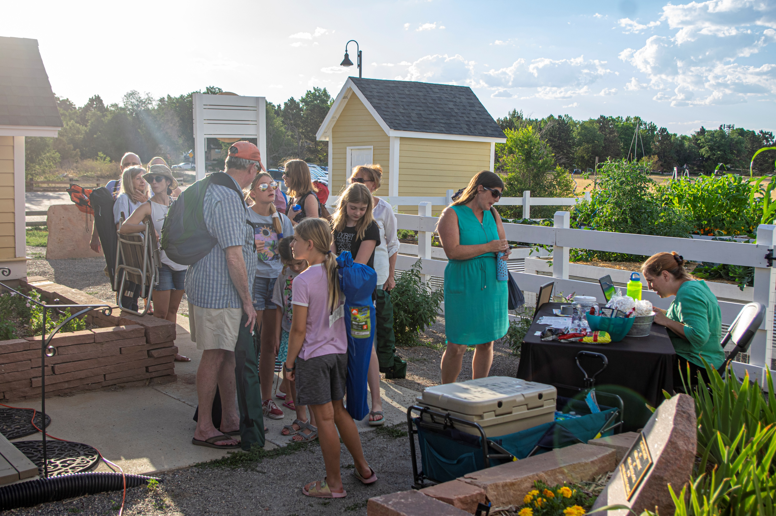
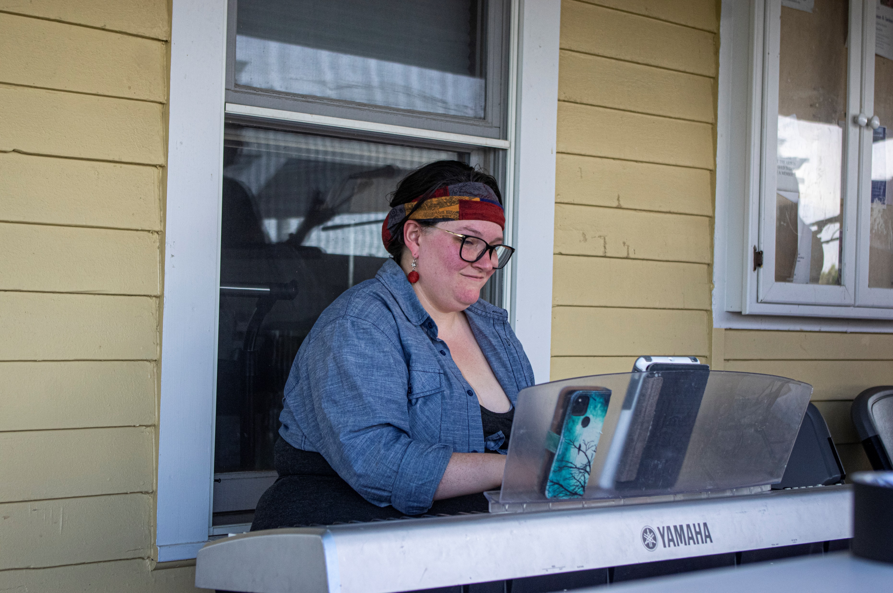
Notes:
[22] July 21, the show at Brunner Farmhouse in Broomfield, Colorado. Microphone checks. Food and water. Geez, it was dry heat. An audience of 50 families, children attended.

Slide 3
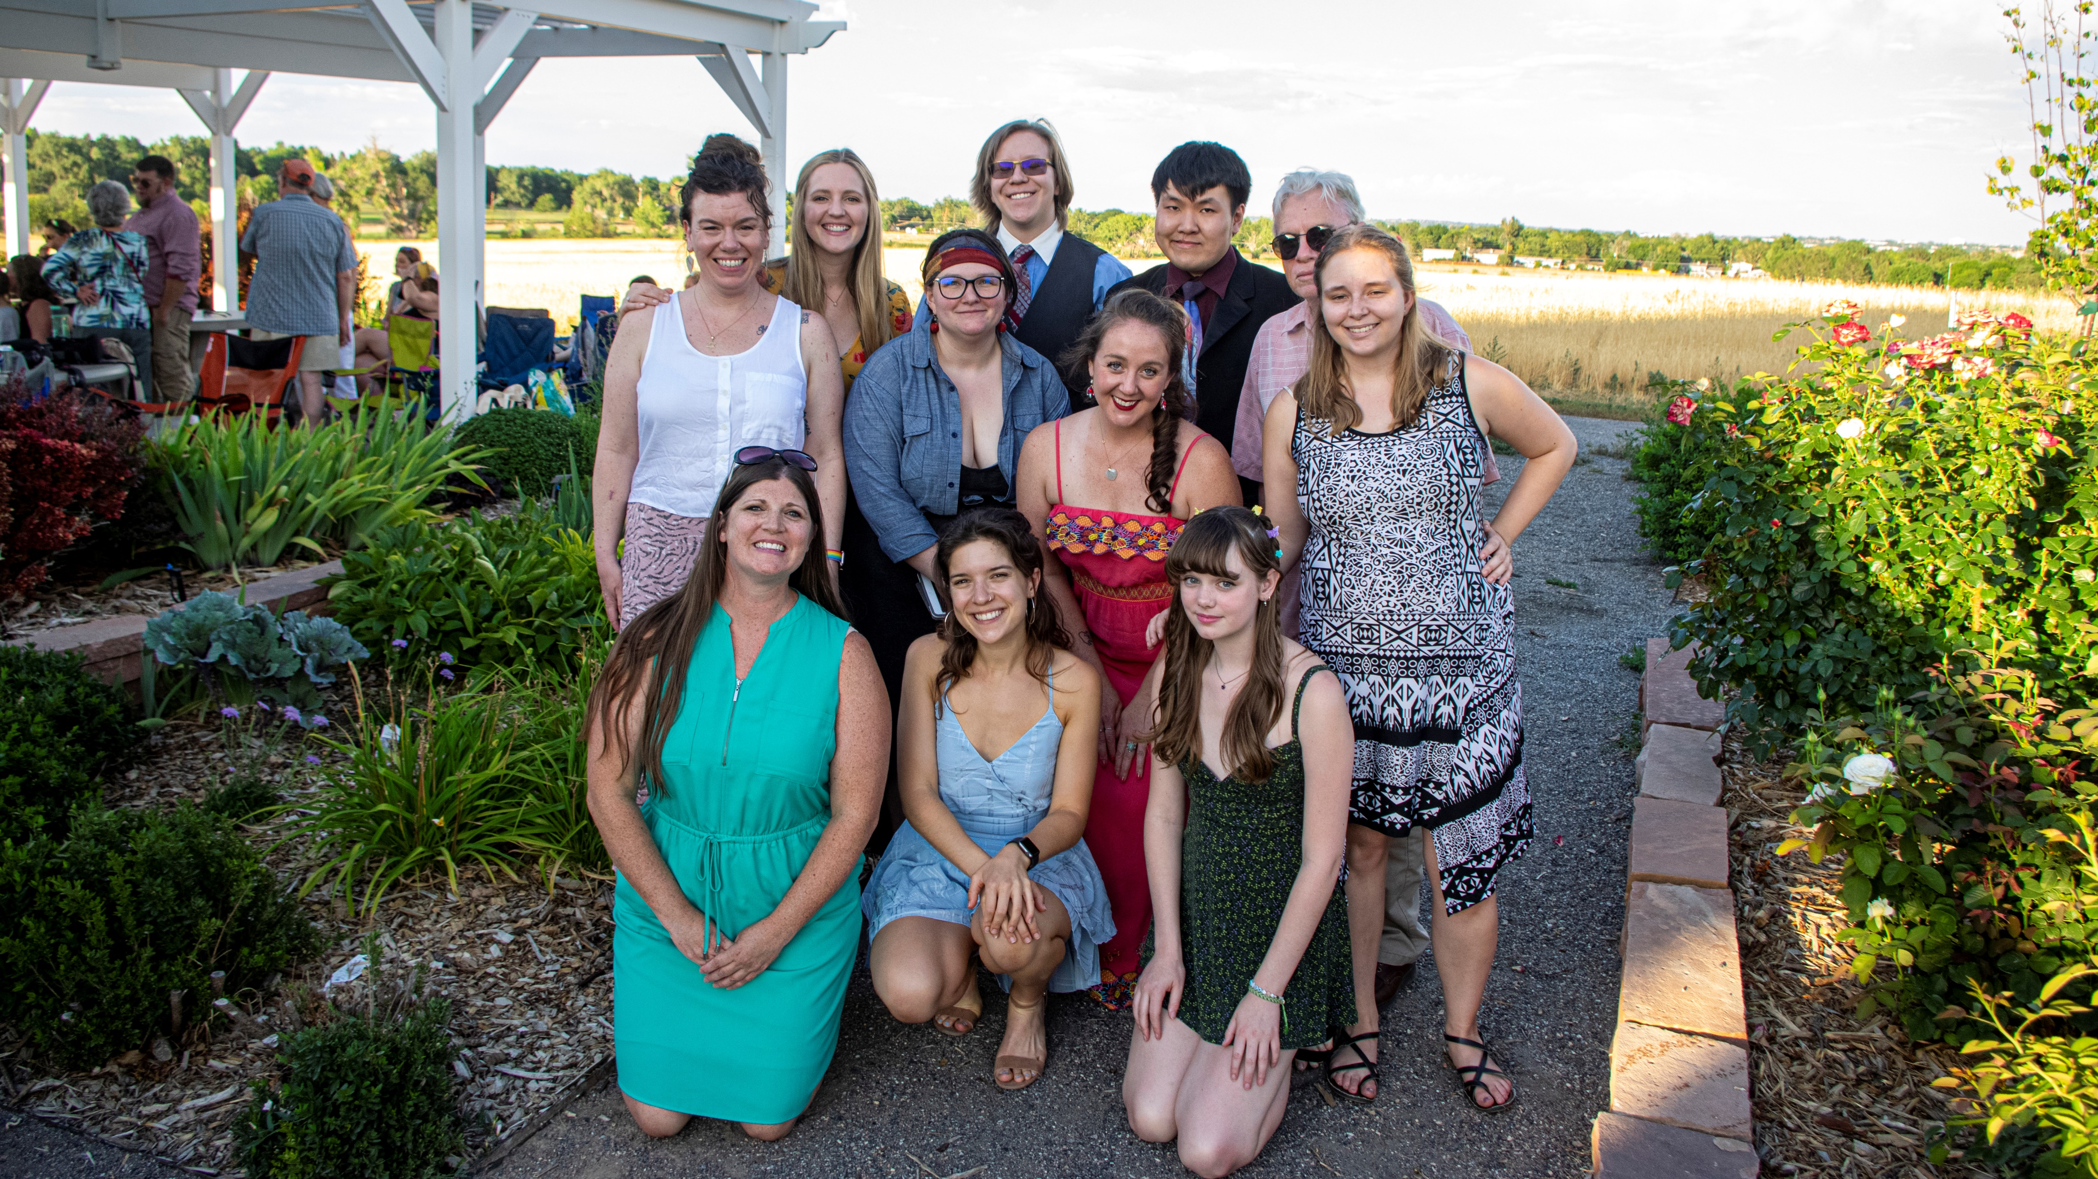
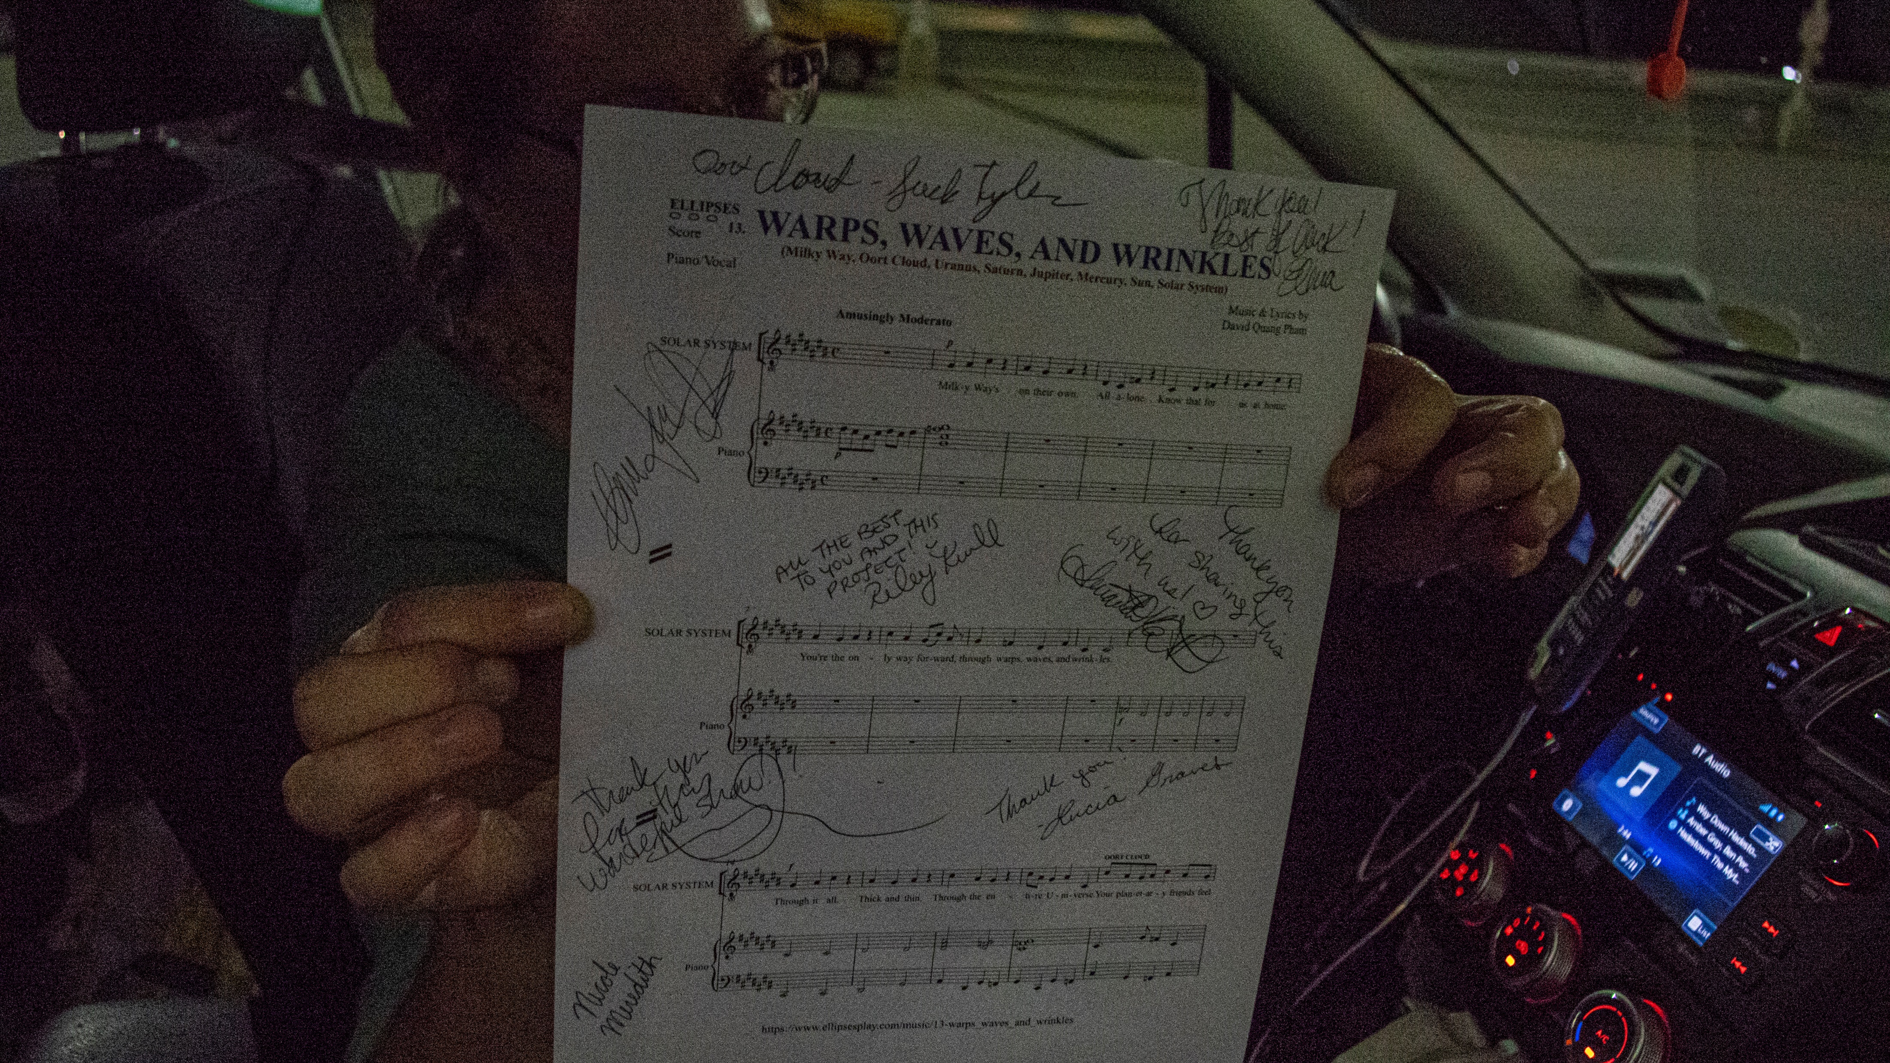
Notes:
[23] The group photo of the ELLIPSES Denver team with singers Amanda Edwards, Lucia Graves, Elicia Hesselgrave, Riley Krull, Nicole Meredith, and Jack Tyler. [23-] In development, “Warps, Waves, and Wrinkles” did not layman’s term anything. I was kind of anxious that the kids would come out of this confused and bored.

Slide 4
Quote
“This story is unique, fantastical, interesting, and important not just for its own sake but, as you have said, as a vehicle to make science more accessible. Your concept is genuinely so intriguing!”
Emma Day
Notes:
[24] But afterwards, they got the gist of the astrophysics terminology that I laid before them. Scutum-crux arm… We’re home on the Orion, arm so small and so minor. The kids know that the Solar System is located on the Orion arm of the Milky Way. They don’t have to know on the getgo what the other arms mean. The melody plants a curiosity in them and their parents to research what was being sung. It indirectly engages the audience into science enthusiasm.

Slide 5
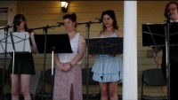
Notes:
[25] This is the preview of what you’ll see in the exhibit and a part of the 15-minute showcase of “Warps, Waves, and Wrinkles.”

Slide 6
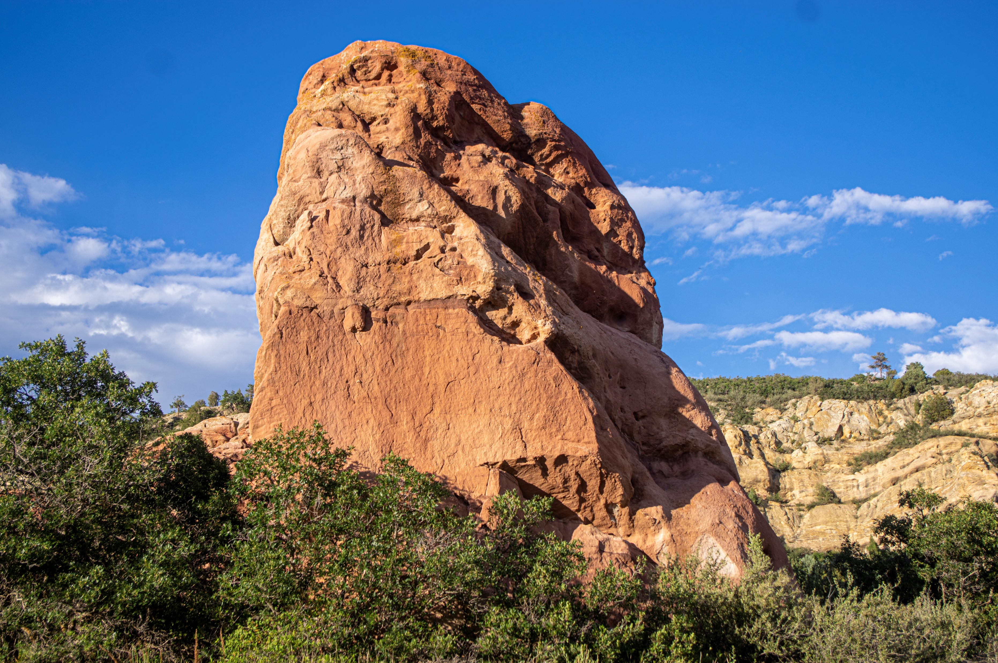
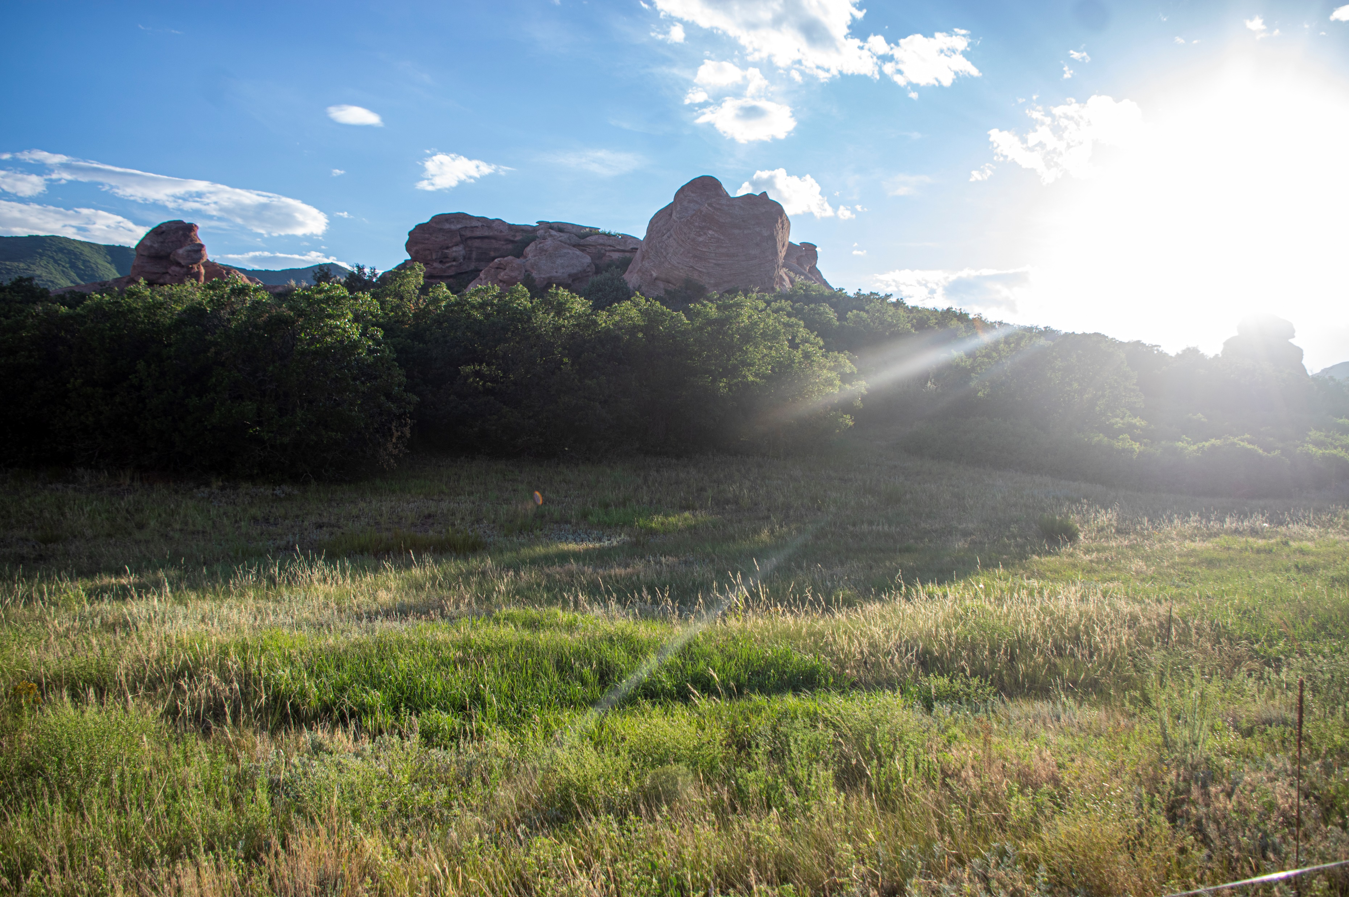
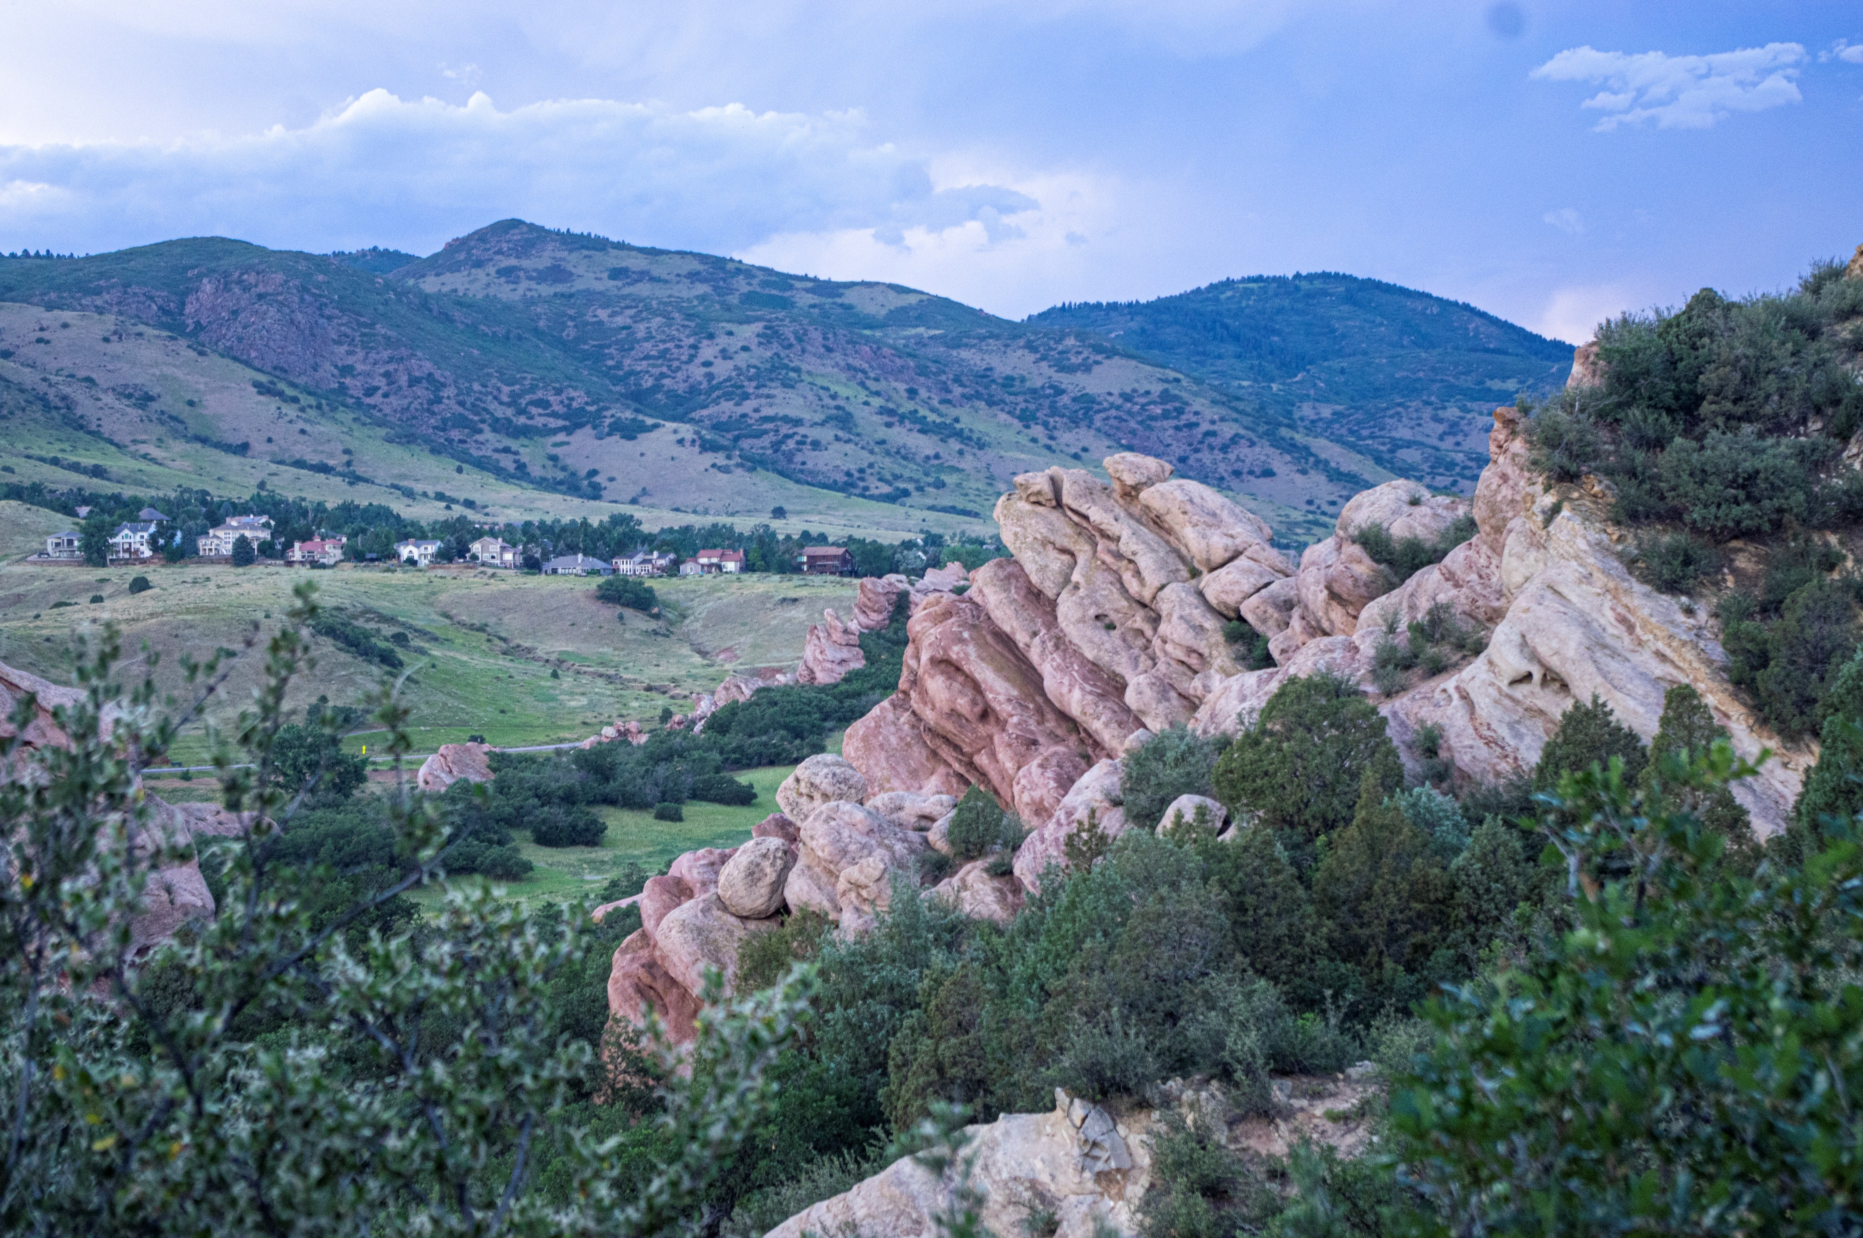
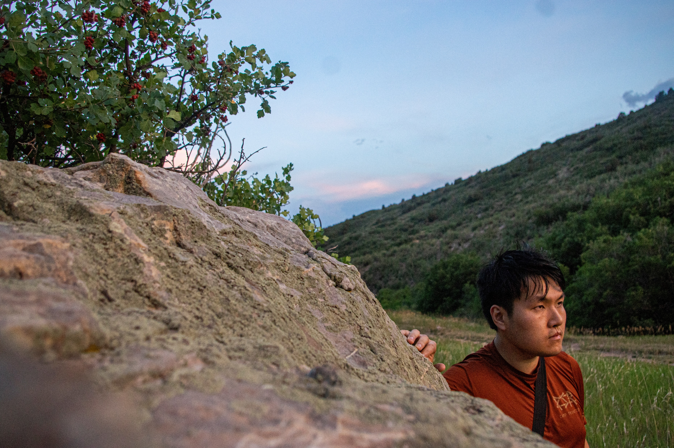
Romancing the Stone
Notes:
[26] To end on this theme and my favorite place in Denver: South Valley Park where the red rock formation rests. When a collaboration is created for the intention of creating a new musical, the playwright-composer determines whether the script is set in stone or whether the stone weathers the director’s and performers’ ideas and experimentations. I let my stone ELLIPSES go through a natural erosion this past year. Now, this stone got a chance to be artificially layered this past July.

Slide 7
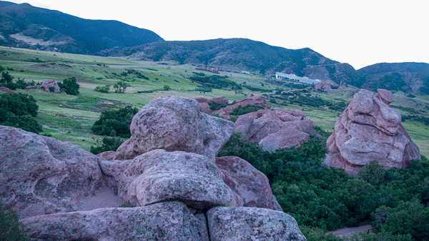
Notes:
[27] Out of this lockdown, I finally got to enjoy and not take for granted: nature.

Slide 8


Dankie!
Notes:
[28] You can follow what’s next for ELLIPSES and me at @ellipsesplay. Dankie for your spacetime.

